Slide 1
Coherent-Event analysis
Definition
Determine overlapping spindle events between (within 750 ms post-stimulus)
FRO – PAR
FRO – CA1
PAR – CA1
Additionally check whether these coherent events contain an offline-detected ripple event
FRO-Spi
CA1-Spi
CA1-Ripple
Coherent FRO-CA1
spindle event
Coherent FRO-CA1
Spindle-ripple event

Slide 2
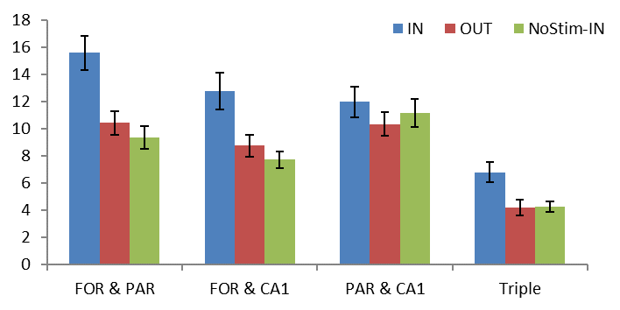
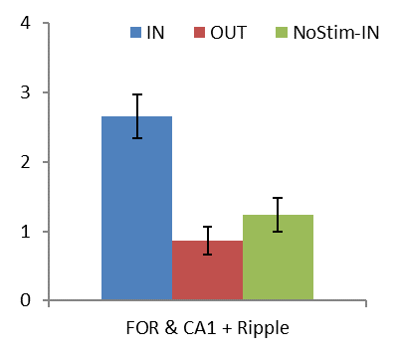
Slow spindles
Incidence rate (%)
Only In-phase stimulation increases probability of frontal-parietal, frontal-hippocampal and global spindle events
Same holds for frontal-hippocampal events including ripples

Slide 3
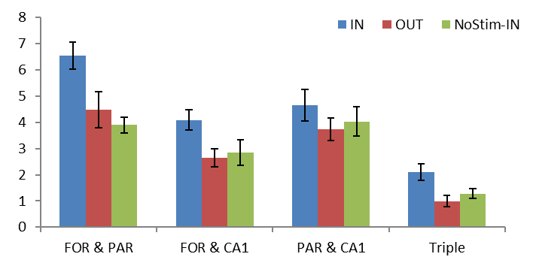
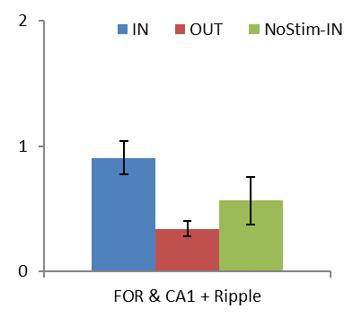
Broadband spindles
Incidence rate (%)

Slide 4
Coherent-Event analysis
Analysis - Cross-Covariance
Determine delay between frontal and hippocampal spindles
Use window +/- 100 ms spindle range
Due to low number of cases events are pooled across all mice for each condition
100 ms
100 ms
FRO-Spi
CA1-Spi
Spindle range
Analysis window

Slide 5
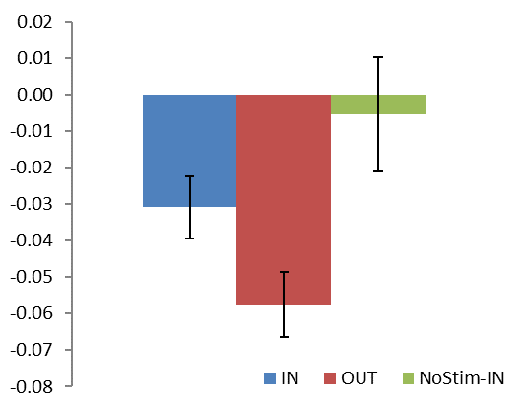
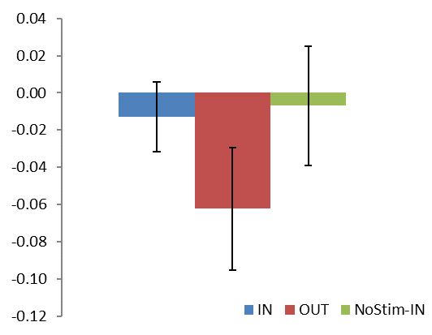
Slow spindles
FRO-CA1 Spindle events
FRO-CA1 Spindle-Ripple events
Lag between FRO and CA1 spindles

Slide 6
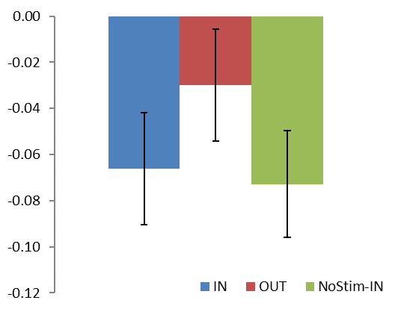
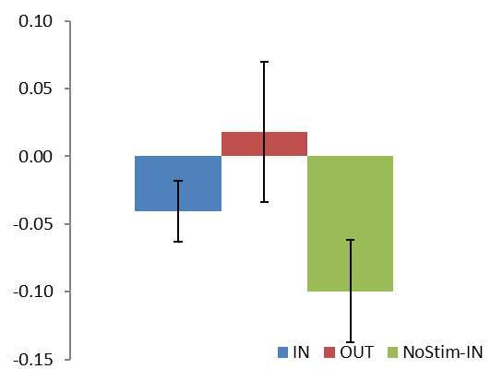
Broadband spindles
FRO-CA1 Spindle events
FRO-CA1 Spindle-Ripple events
Lag between FRO and CA1 spindles

Slide 7
Coherent-Event analysis
Ripple-locked analysis
Select ripples within frontal-hippocampal spindle events
Average raw FRO and CA1 EEG-signal and signal filtered in spindle band
Time-frequency plots of spindle troughs
Analysis also performed over pooled data
Spindle trough locked analysis
Select troughs of frontal spindles within coherent events
Perform time-frequency analysis from 100 to 250 Hz on both FRO and CA1
Event correlation of CA1 spindle troughs time-locked to frontal spindles

Slide 9
Coherent FRO-CA1 Spindle events – Slow spindles
IN
NOStim-IN
OUT
NOStim-OUT
t = 0 equals spindle troughs of frontal spindles (within coherent events)
Time-frequency plots span rippleband frequency for FRO and CA1 recordings
Middle: Average ripple power derived from time-frequency plots
Bottom: Event correlation of CA1-spindle troughs with respect to FRO spindles

Slide 10
Coherent FRO-CA1 Spindle events – Broadband spindles
IN
NOStim-IN
OUT
NOStim-OUT

Slide 11
Coherent FRO-CA1 Spindle-Ripple events – Slow spindles
IN
NOStim-IN
OUT
NOStim-OUT

Slide 12
Coherent FRO-CA1 Spindle-Ripple events – Broadband spindles
IN
NOStim-IN
OUT
NOStim-OUT

